Slide 1
Transformer in Vision
Han Myungein
Master of Biomedical Engineering
University of Melbourne

Slide 2
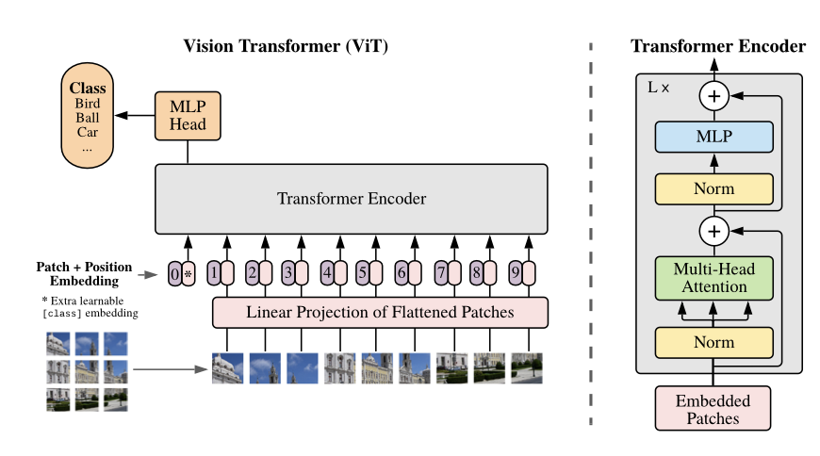
Application of Transformer in Vision: Vision Transformer
Introduced at ‘An Image is Worth 16x16 Words: Transformer for Image Recognition at Scale (Google, 2020)’
After applying Transformer in NLP, researchers wondered if we can apply Transformer in Vision as well.
Here ViT (Vision Transformer) comes in!!
Vit is the first key innovation of Transformer in Vision.

Slide 3
Vision Transformer Characteristics
Vit uses self-attention and it treats the whole image at once
As we are using self-attention mechanism, we can capture global relationships between different image patches
CNN model with convolution layers treats the image in many convolution layers extracting different features in different convolution layers
ViT doesn’t have a decoder, it only has an encoder
Input would be image patches and patches go through positional encoding to provide spatial information of the patches and then it is concatenated
Image Patches -> Positional Encoding -> Concatenation
ViT is used to classify an image. For example, through ViT, we can classify an image a bird, car etc.

Slide 4
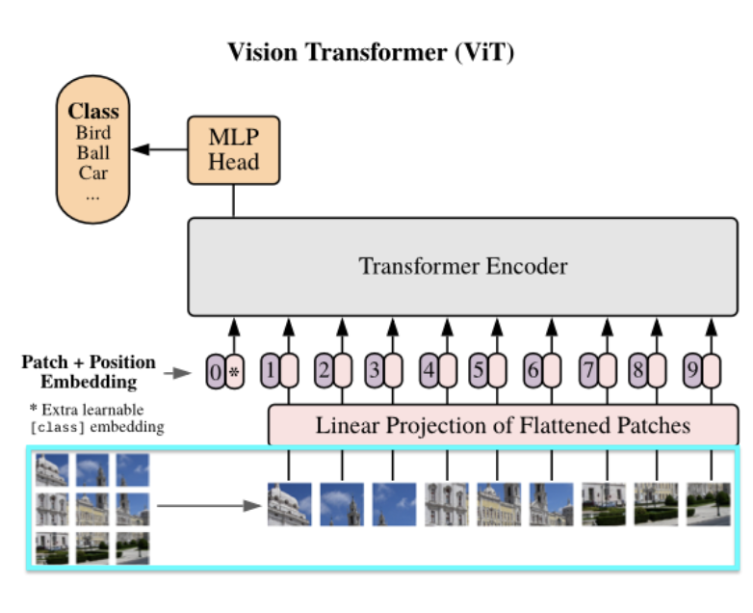
Shortcomings of Vision Transformer
ViT model can not fully reflect the image characteristics of 2D images as the image patch is inputted from image left to right, top to bottom
-> Swin Transformer or CvT model were proposed
Swin Transformer was a big breakthrough in Vision Recognition!

Slide 5
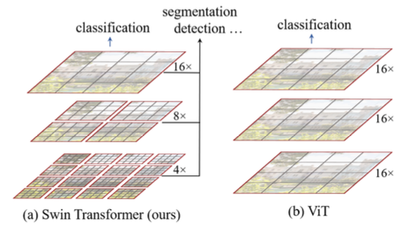
Swin Transformer
Introduced at ‘Swin Transformer: Hierarchical Vision Transformer using Shifter Windows (Microsoft, 2021)’
What are the differences btw ViT and Swin Transformer?
<ViT>
Same number and size of patches used for every single layer that goes through the attention mechanism
Can’t get small, large details as much as swin transformer
<Swin Transformer>
Different number and size of patches used for each of the layers that goes through the attention mechanism
Able to get small, large details much better than ViT!

Slide 6
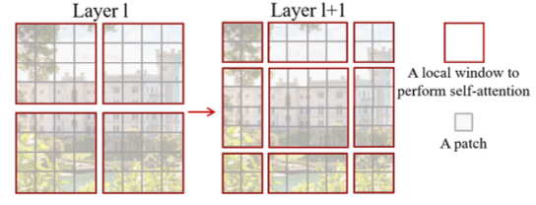
Swin Transformer Characteristics
Hierarchical Architecture
Patch number, size are different in each of the hierarchical layers
Captures both local and global information
Shifted Windows
Unlike ViT that uses fixed-size patches, Swin makes the receptive field of neighboring patches to overlap
Local and Global Attention
Local attention captures the fine-grained details
Global attention captures the characteristics of the entire image

Slide 7
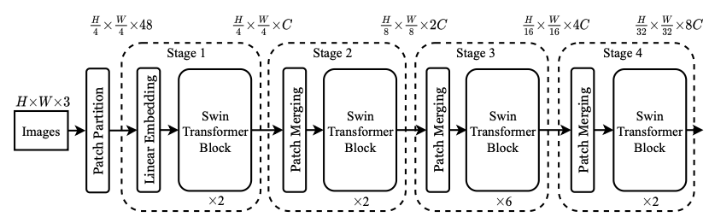
Swin Transformer Architecture
Image Partitioning
Divided into patches
Linear Embedding
Each of the patches becomes a vector
Swin Transformer Block
Multi-head Self-Attention Mechanism
Feed-Forward Neural Network(FFNN)
Residual Connection
Layer Normalization
Position-wise Feed-Forward Networks(PFFNs)
Patch Merging
Performs a classification of the entire image

